Slide 1


Provide Insights to
Management in
Consumer Goods Domain
created by: Nusaif Ali

Slide 2
Presentation Overview
1. Business Background & Context
2. Overview of Company Operations, Markets & Products
3. Understanding the available data
4. Ad-hoc Business Queries, Insights & Visualizations

Slide 3
1. Business Background
About the Company
Atliq Hardwares is a hypothetical organization and a well-known manufacturer of computer hardware products across India.
Business Situation
The management identified challenges in accessing timely and meaningful insights for quick, data-driven decision-making.
Challenge
The organization received several ad-hoc business questions that required analytical insights.
Methodology
SQL-based analysis was performed, and the results were converted into visual insights to support senior management decisions.

Slide 4
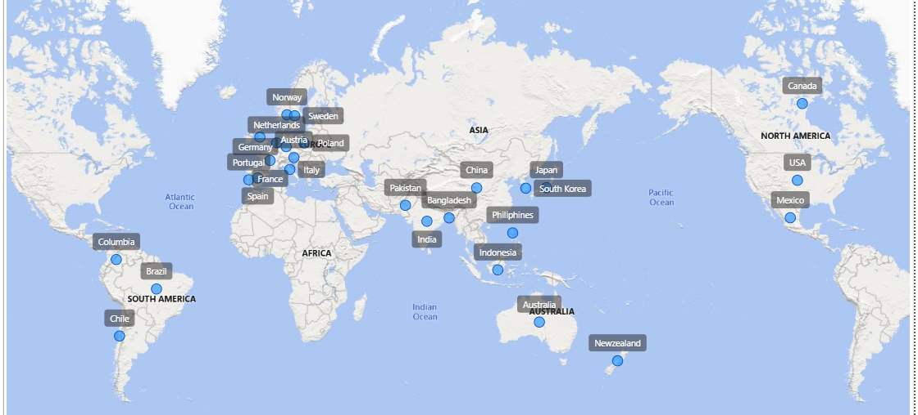
2.1 - Company's Market
Market & Customers
Atliq operates across multiple global markets and serves a wide customer base. The company has a presence in regions such as North America, Latin America, Asia Pacific, and Europe. This global footprint enables data-driven market strategies tailored to regional and customer-specific needs.

Slide 5
FISCAL YEAR
September 2019 – August 2020
(FY 2020)
September 2020 – August 2021
(FY 2021)
2.2 Company Details
Atliq Hardware is a consumer electronics company that manufactures and sells hardware products to various customer segments.
The company offers a wide range of products, organized into three major divisions to improve operational efficiency and performance tracking:
• Network & Storage: Routers, Drivers, Wi‑Fi Extenders
• Peripherals & Accessories: Mouse, Batteries, Graphic Cards, etc.
• Personal Computers: Desktops and Laptops
These divisions help the company analyze sales trends, monitor margins, and make data‑driven decisions across product categories.

Slide 6
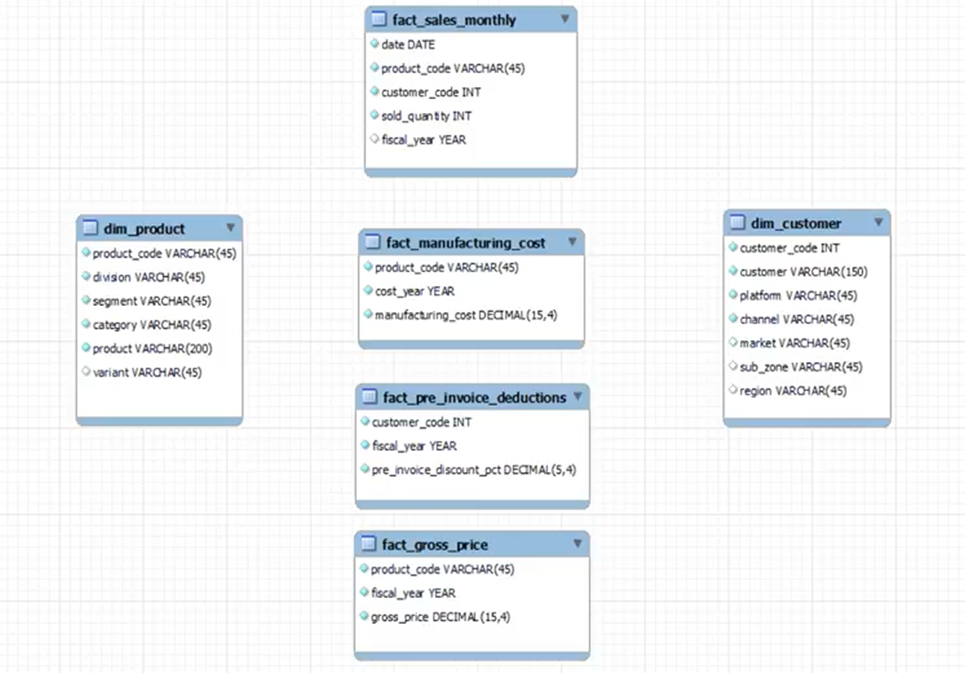
3. Understanding the available data
The input dataset contains sales data for FY 2020 and FY 2021, along with multiple dimension tables such as customer details, product information, market data, and pricing attributes.

Slide 7

4. Ad-hoc Business Queries, Insights & Visualizations

Slide 8
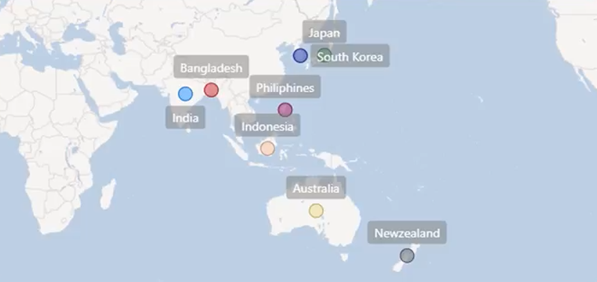
Request 1
1. Provide the list of markets in which customer "Atliq Exclusive" operates its business in the APAC region.
Insights
In the APAC region, our exclusive store has established its presence in 8 major markets

Slide 9
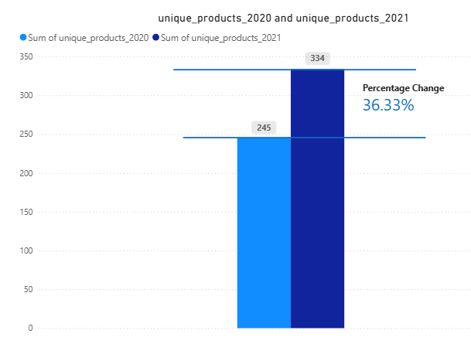
Request 2
2. What is the percentage of unique product increase in 2021 vs. 2020? The final output contains these fields, unique_products_2020
unique_products_2021
percentage_chg
Insights
The increase in the number of unique products indicates a strong focus on innovation and product expansion. Between FY 2020 and FY 2021, the product portfolio grew by over 36%, reflecting the company’s ability to consistently introduce new offerings and strengthen its market presence.

Slide 10
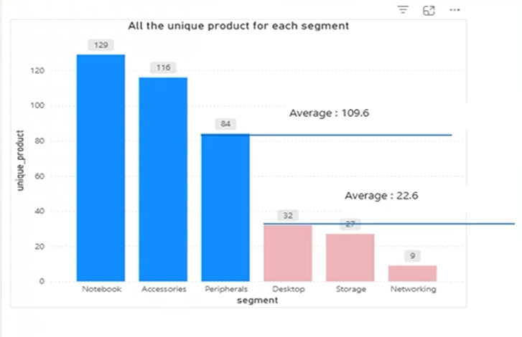
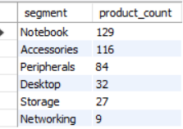
Request 3
3. Provide a report with all the unique product counts for each segment and sort them in descending order of product counts. The final output contains 2 fields, segment product_count
Key Insights
Notebook has the highest number of unique products (129), indicating a strong focus on laptops.
Accessories (116) and Peripherals (84) are also significant segments, suggesting high demand for add-on and supporting products.
Desktop (32) and Storage (27) have comparatively fewer products, indicating limited product variety.
Networking (9) has the lowest product count, showing it is not a primary focus area for the company.
Conclusion
The company’s product portfolio is heavily concentrated in Notebooks, Accessories, and Peripherals, which form the core business segments. In contrast, Networking remains a smaller segment with minimal product variety.

Slide 11
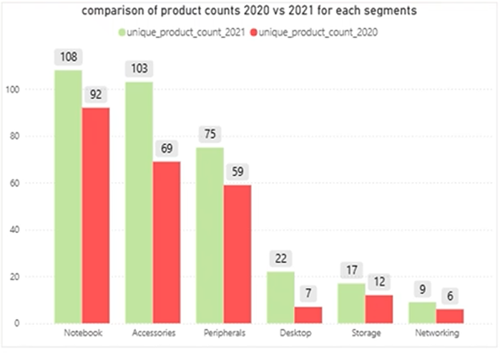
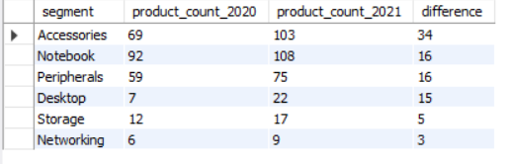
4. Follow-up: Which segment had the most increase in unique products in 2021 vs 2020? The final output contains these fields, segment, product_count_2020, product_count_2021, difference
Request 4
Key Insights
Product expansion is strongest in Accessories and core computing segments.
Notebook and Peripherals continue to be key focus areas.
Networking remains the smallest and least prioritized segment.
Conclusion
The company is investing more in popular product categories and less in smaller ones.

Slide 12



5. Get the products that have the highest and lowest manufacturing costs. The final output should contain these fields, product_code, product, manufacturing_cost
Request 5
$250.54
$0.89
AQ HOME Allin1 Gen 2 Personal Desktop
AQ Master wired x1 Ms Mouse
Key Insights
AQ Home Allin1 Gen 2 – Personal Desktop has the highest manufacturing cost at $240.54, indicating that desktop products are significantly more expensive to produce compared to other categories.
AQ Master Wired X1 MS – Mouse has the lowest manufacturing cost at $0.89, showing that basic peripherals can be produced at very low cost.

Slide 13
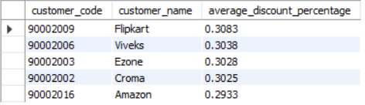
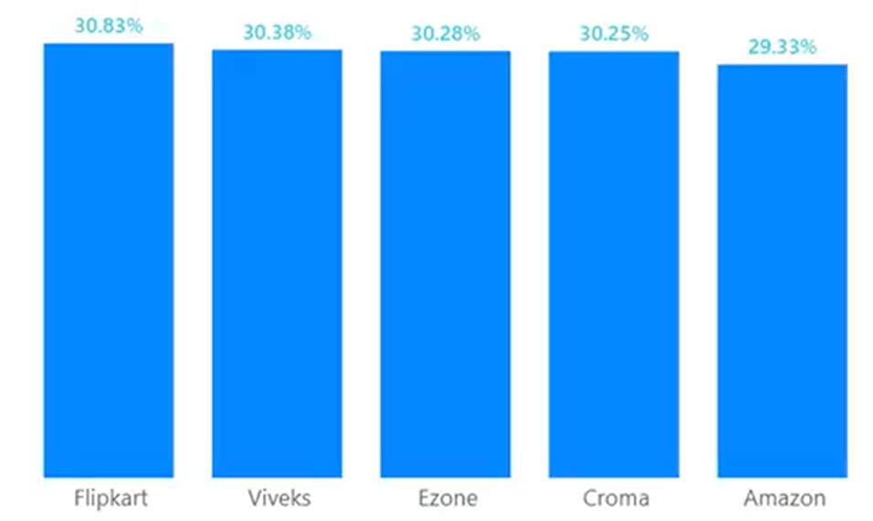
6. Generate a report which contains the top 5 customers who received an average high pre_invoice_discount_pct for the fiscal year 2021 and in the Indian market. The final output contains these fields, customer_code customer average_discount_percentage
Request 6
Key Insights
In 2021, the company offered almost the same pre-invoice discount levels to its top five customers in the Indian market, indicating a consistent and standardized discount strategy.
Among these customers, Flipkart received the highest average discount (30.83%), followed closely by Viveks, Ezone, and Croma, while Amazon received a slightly lower discount at 29.33%.

Slide 14
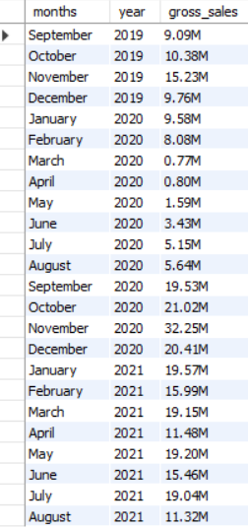
Request 7
7. Get the complete report of the Gross sales amount for the customer “Atliq Exclusive” for each month . This analysis helps to get an idea of low and high-performing months and take strategic decisions. The final report contains these columns: Month, Year, Gross sales Amount
FY 2020
FY 2021

Slide 15
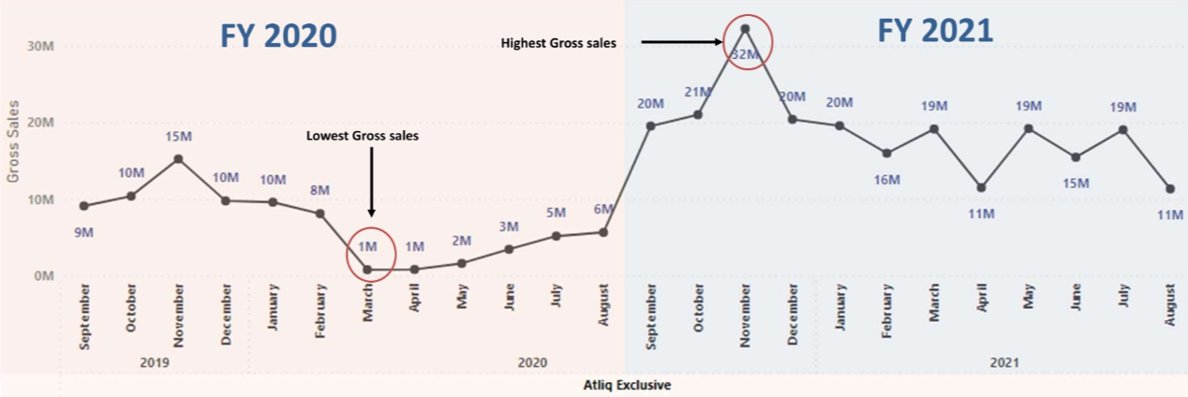
Insights
November 2020 recorded the highest sales, while March 2020 was the lowest for Atliq Exclusive.
The sales drop from March to August 2020 is mainly due to the impact of COVID-19.
Sales recovered strongly after August, and FY 2021 performed much better than FY 2020 overall.

Slide 16
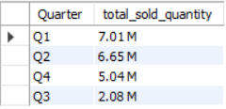
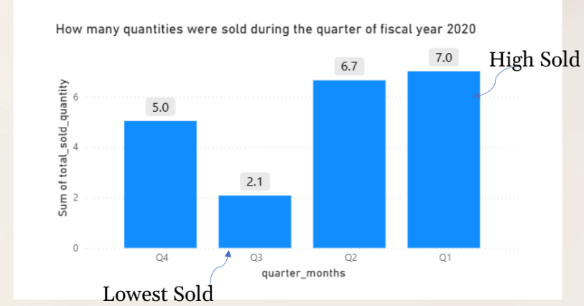
Request 8
8. In which quarter of 2020, got the maximum total_sold_quantity? The final output contains these fields sorted by the total_sold_quantity, Quarter total_sold_quantity.
Insights
Atliq Hardware achieved its highest total sales volume in Q1 of FY 2020, with around 7.01 million units sold.
The lowest sales volume was recorded in Q3 of FY 2020, at approximately 2.08 million units.
The sharp decline in sales during Q3 is most likely due to the COVID-19 pandemic, which disrupted business activities mainly between March and May 2020.

Slide 17
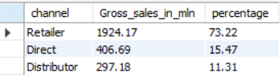
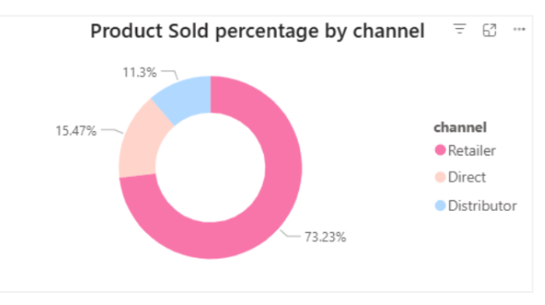
9. Which channel helped to bring more gross sales in the fiscal year 2021 and the percentage of contribution? The final output contains these fields, channel, gross_sales_mln, percentage
Request 9
Insights
Most of our sales came through retailers, making up around 75% of the total sales. Only a small portion of sales came from the direct and distributor channels.

Slide 18
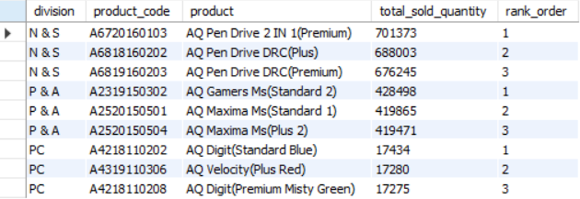
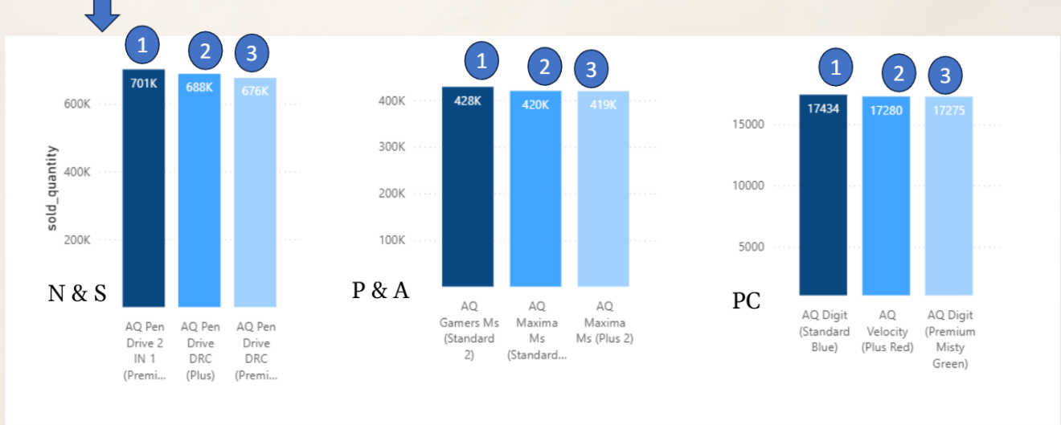
10. Get the Top 3 products in each division that have a high total_sold_quantity in the fiscal_year 2021? The final output contains these fields, division, product_code,product total_sold_quantity, rank_order
Request 10
Insights
In the Network & Storage (N & S) category, pendrives recorded the highest sales, with nearly 7 lakh units sold.
In the Peripherals & Accessories category, the mouse was the best-selling product, with close to 4 lakh units sold.
In the PC category, the personal laptop was the top-selling product, with approximately 1,700 units sold.

Slide 19
THANK YOU

